Slide 1
Calibrating a macroprudential policy model for the Romanian economy
Phd. Student: Aliman Mihai
Professor: prof. univ. dr. Necula Ciprian
FABBV Doctoral School Presentation, april 2023

Slide 2



Abordarea autorităților europene
European authorities typically rely on DSGE models for calibrating and assessing their macroprudential policies.
One of the most common models used is Gerali et al. (2010).
Banca Centrală Europeană Darracq Pariès, Jacquinot, Papadopoulou (2016)
Cozzi et al. (2021) Darracq Pariès, Kok Sørensen, Rodriguez-Palenzuela (2018)
Mendicino, Nikolov, Suarez, Supera (2018)
Coenen, Karadi, Schmidt, Warne (2018)
Banca Centrală a Franței Gerali, Neri, Sessa, Signoretti (2010)
Bennani et al. (2017) Mendicino, Nikolov, Suarez, Supera (2018)
Banca Centrală a Germaniei Gerali, Neri, Sessa, Signoretti (2010)
Hristov și Hülsewig (2017)

Slide 3
Gerali et al. (2010) (1)
Pacient (higher discounting factors)
Households consume, work, accumulate housing
Impacient (lower discounting factors)
Entrepreneurs → produce homogenous intermediate goods using capital, bought from capital-good producers, and hired labor
Banks → offer saving contracts (deposits) and borrowing contracts (loans)
→ set interest rates so as to maximize profit (monopolistic behavior)
→ are subject to a capital requirement and it’s costly to hold more capital than the required level
→ the amount of loans issued can be financed through deposits and bank capital, which is accumulated out of profits.
Borrowing constraint → households can borrow against the value of their stock of housing, while entrepreneurs against physical capital
Patient households → purchase a positive amount of deposits and do not borrow, while impatient households and entrepreneurs borrow a positive amount of loans
Production side → workers supply their differentiated labor services through unions, which set wages to maximize members’ utility subject to adjustment costs.
→ in addition to entrepreneurs, there are two other producing sectors: a monopolistically competitive retail sector and a capital goods producing sector. Retailers buy intermediate goods from entrepreneurs in a competitive market, differentiate and price them subject to nominal rigidities. Capital goods producers are introduced so to derive a market price for capital.

Slide 4



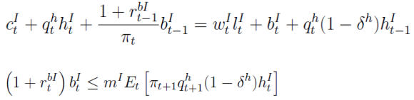


Gerali et al. (2010) (2)
Patient Households
Impatient Households
Wage setting by labour union

Slide 5


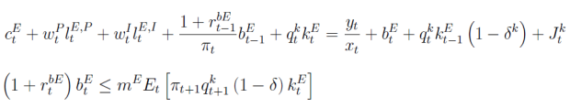

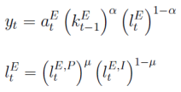



Gerali et al. (2010) (3)
Entrepreneurs
Capital goods producers
Final goods producers
Intermediary goods formation
Market clearing
Monetary policy

Slide 6

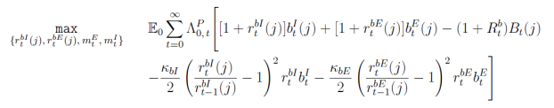








Gerali et al. (2010) (4)
Loans and deposit demand
Credit Branch
Wholesale branch
Deposit branch
Overall bank profits

Slide 7
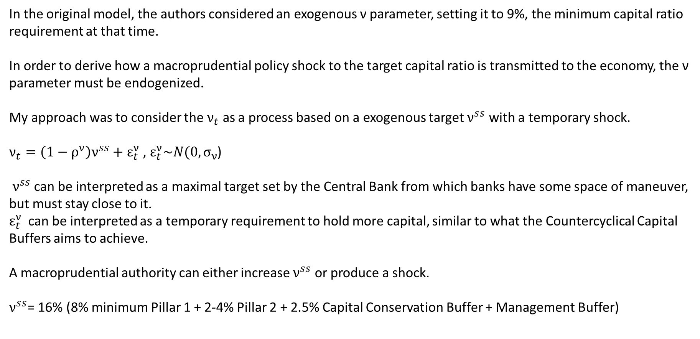
Gerali et al. (2010) (5)
In the original model, the authors considered an exogenous ν parameter, setting it to 9%, the minimum capital ratio requirement at that time.
In order to derive how a macroprudential policy shock to the target capital ratio is transmitted to the economy, the ν parameter must be endogenized.
My approach was to consider the $ν_{t}$ as a process based on a exogenous target $ν^{ss}$ with a temporary shock.
$ν_{t}=\left(1−ρ^{ν}\right)ν^{ss}+ε_{t}^{ν}$ , $ε_{t}^{ν}\sim N(0,σ_{ν}$)
$ν^{ss}$ can be interpreted as a maximal target set by the Central Bank from which banks have some space of maneuver, but must stay close to it.
$ε_{t}^{ν}$ can be interpreted as a temporary requirement to hold more capital, similar to what the Countercyclical Capital Buffers aims to achieve.
A macroprudential authority can either increase $ν^{ss}$ or produce a shock.
$ν^{ss}$= 16% (8% minimum Pillar 1 + 2-4% Pillar 2 + 2.5% Capital Conservation Buffer + Management Buffer)

Slide 8
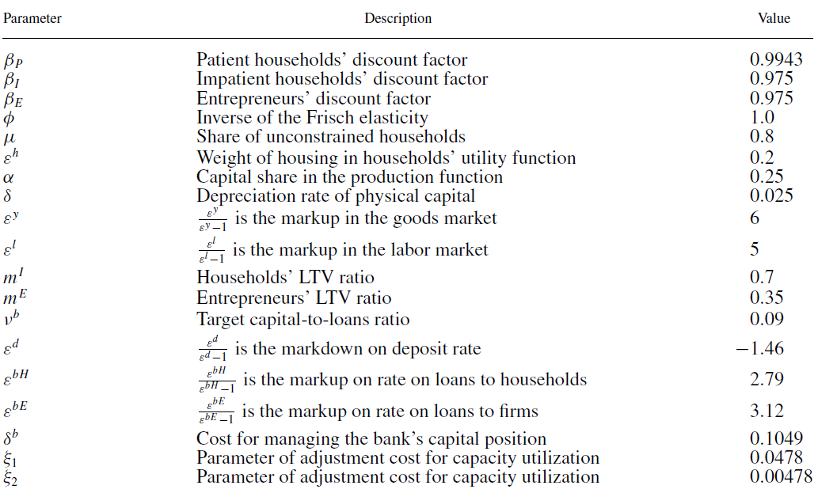

Gerali et al. (2010) (6)
Calibrated parameters
0.9963 (Copaciu et al. 2013)
7.822 (Copaciu et al. 2013)
0.9 (NBR data on no. of debitors)
0.55 (Copaciu et al. 2013)
0.049 (Copaciu et al. 2013)
0.71 (NBR FSR 2022)
$ν^{ss}$ = 0.16
(NBR data on interest rates)
(NBR data on interest rates)
(NBR data on interest rates)
0. (recalculation)
0.0716 (recalculation)
0.00716 (recalculation)

Slide 9
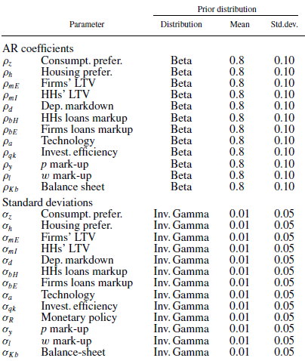
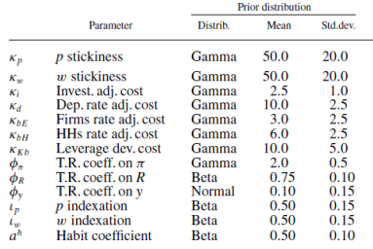
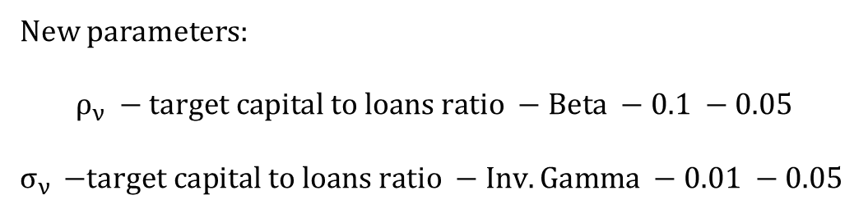
Gerali et al. (2010) (7)
Estimated parameters
New parameters:
$$ρ_{ν} −target capital to loans ratio −Beta −0.1 −0.05$$
$σ_{ν }$ $−target capital to loans ratio −Inv. Gamma −0.01 −0.05$

Slide 10
Data Series for Romania Estimation
Period: 2007 Q1 – 2022 Q4. All nominal series were deseasonalized and adjusted by the GDP deflator (Pfeifer 2014).

Slide 11
Rezultate șoc politică monetară

Slide 12
Rezultate șoc tehnologie

Slide 13
Rezultate cu șoc capital bancar

Slide 14
Conclusion
Obiectivul 1

Slide 15
Bibliografie
Bennani, Taryk, Cyril Couaillier, Antoine Devulder, Silvia Gabrieli, Julien Idier, Pierlauro Lopez, Thibaut Piquard, and Valerio Scalone. "An Analytical Framework to Calibrate Macroprudential Policy.", Banque de France, Working Paper 648 (2017).
Coenen, Günter, Peter Karadi, Sebastian Schmidt, and Anders Warne. "The New Area-Wide Model II: an extended version of the ECB’s micro-founded model for forecasting and policy analysis with a financial sector.„ ECB Working Papers 2200 (2018).
Darracq Pariès, Matthieu, Pascal Jacquinot, and Niki Papadopoulou. "Parsing financial fragmentation in the euro area: a multi-country DSGE perspective.„ ECB Working Papers 1891 (2016).
Gerali, Andrea, Stefano Neri, Luca Sessa, and Federico M. Signoretti. "Credit and Banking in a DSGE Model of the Euro Area." Journal of money, Credit and Banking 42 (2010): 107-141.
Hristov, Nikolay, and Oliver Hülsewig. "Unexpected loan losses and bank capital in an estimated DSGE model of the euro area." Journal of Macroeconomics 54 (2017): 161-186.
Mendicino, Caterina, Kalin Nikolov, Javier Suarez, and Dominik Supera. "Optimal dynamic capital requirements." Journal of Money, Credit and Banking 50, no. 6 (2018): 1271-1297.
Paries, Matthieu Darracq, Christoffer Kok Sørensen, and Diego Rodriguez-Palenzuela. "Macroeconomic propagation under different regulatory regimes: Evidence from an estimated dsge model for the euro area." 27th issue (November 2011) of the International Journal of Central Banking (2018).
Pfeifer, Johannes. "A guide to specifying observation equations for the estimation of DSGE models." Research series (2014): 1-150.

Slide 16
Thank you for your attention!
mihaialiman@gmail.com
+40 722 624 828

